Slide 1
TECHNOLOGY ACCEPTANCE MODEL (TAM)
Information Systems Theory
Chapter 11

Slide 2
Objectives
By the end of this chapter, you should know –
The various theories that attempt to predict the impact of technology on human behavior.
How technology acceptance model accepts or rejects a system.

Slide 3
Introduction
Understanding why people use or discard computers has become one of the most challenging issues.
The prospect that a well-developed system will be used can bring competitive advantage to businesses and individuals.
Emerging information technology can not deliver improved organizational effectiveness if it is not accepted and used by potential users.

Slide 4
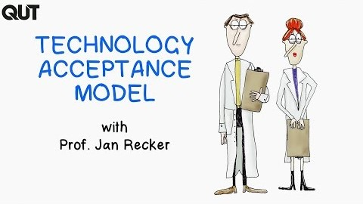
Introduction

Slide 5
Challenges Faced
Understanding why people accept or reject computers had proven to be one of the most challenging issues in information systems –
Users beliefs and attitude is a major determinants
Satisfaction measures are also important
Adaptation to change
Role of culture
Education and awareness are vital

Slide 6
Theories About Technology Acceptance
There exists a number of theories regarding technology acceptance such as –
Theory of Reasoned Action (ToRA or TRA)
Theory of Planned Behaviour (TPB)
Technology Acceptance Model (TAM)
Extended Technology Acceptance Model (TAM 2)
Unified Theory of Acceptance and Use of Technology (UTAUT)
Extended Technology Acceptance Model (TAM 3)

Slide 7
Technology Acceptance Model (TAM)
It was developed by Fred Davis and Richard Bagozzi in 1989.
The model suggests that when users are presented with a new technology, a number of factors influence their decision about how and when they will use it.
The most widely applied model of users' acceptance and usage of technology.
TAM have strong behavioural elements, assume that when someone forms an intention to act, that they will be free to act without limitation.
TAM is one of the most frameworks adopted because of its robustness, simplicity, and applicability in explaining and predicting the attributes that affect user’s adoption behavior towards new technologies

Slide 8
TAM and Diffusion of Innovation Theory
Diffusion of Innovation (DOI) Theory was developed by E.M. Rogers in 1962.
It is one of the oldest social science theories.
It originated in communication to explain how, over time, an idea or product gains momentum and diffuses (or spreads) through a specific population or social system.
The end result of this diffusion is that people, as part of a social system, adopt a new idea, behavior, or product.
The key to adoption is that the person must perceive the idea, behavior, or product as new or innovative.

Slide 9
TAM and Diffusion of Innovation Theory
There are five main factors that influence adoption of an innovation –
Relative Advantage - The degree to which an innovation is seen as better than the idea, program, or product it replaces.
Compatibility - How consistent the innovation is with the values, experiences, and needs of the potential adopters.
Complexity - How difficult the innovation is to understand and/or use.
Triability - The extent to which the innovation can be tested or experimented with before a commitment to adopt is made.
Observability - The extent to which the innovation provides tangible results.

Slide 10
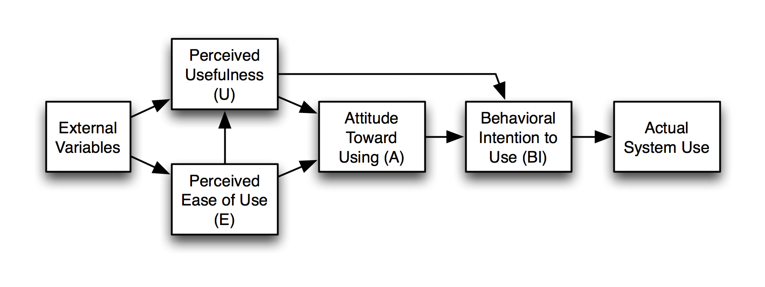
Theoretical Framework of TAM

Slide 11
Theoretical Framework of TAM
This model refers that the user’s actual usage behavior (AU) is directly affected by behavioral intention (intention to use or IU).
In turn, behavioral intention is determined by both the user’s attitude and its perception of usefulness.
The user’s attitude is considered to be significantly influenced by two key beliefs, perceived usefulness (PU) and perceived ease of use (PEOU)
These beliefs might be influenced by some external variables.

Slide 12
Theoretical Framework of TAM
External Variables
Design features
Prior usage and experience
Computer self-efficacy
Confidence in technology

Slide 13
Theoretical Framework of TAM
Perceived Usefulness and Perceived Ease of Use
Perceived Usefulness (PU) refers to the degree to which a person believes that using a particular system would enhance his/her job performance.
Perceived ease of use (PEOU) refers to the degree to which a person believes that using a particular system would be free of effort.
Perceived usefulness and perceived ease of use are distinct but related constructs.
The concepts of perceived usefulness and perceived ease of use are individual subjective judgments about the usefulness and ease toward specific system.

Slide 14
Theoretical Framework of TAM
Perceived Usefulness and Perceived Ease of Use
Perceived usefulness
Work more quickly
Job performance
Increased productivity
Effectiveness
Makes job easier
Useful
Perceived ease of use
Easy to learn
Clear and understandable
Easy to become skillful
Easy to use
Controllable
Easy to remember

Slide 15
Theoretical Framework of TAM
Attitude towards using
Human attitudes towards the use of technology effectively in their daily lives.
Behavioral intention to use
It reflects the extent to which a person purposes (intended) to purchase particular products or services.
Actual system use
It refers to the frequency, time, and money which an individual devotes while using an application.

Slide 16
Application of TAM
TAM are implemented and tested for a variety of application. Some of the common application context include –
Online banking
Online shopping
E-government
E-commerce
M-applications

Slide 17
THANK YOU

